Slide 1
HR Analytics (Employee Retention)
Guided By
DIPITI
Presented By
REDDY ESWAR THAI BABU
ATHULYA LAL P M
TAIBA ASIF CHAUS
GARGEY DUDHE
RUPPA JANARDHANA RAO
SIDDESH KESHAV SANGLE
SREEKANTH REDDY SIDDAMURTHY

Slide 2
Introduction:
We performed an analysis on HR data for employee retention having 50,000+ records and drawn KPI from it using excel, my SQL and also used visualization tools like tableau and also used power bi to make dynamic dashboard.
We got some insights regarding attrition of employees with respect to department, monthly income, work life balance, years of promotion etc.

Slide 3
Key Performance Indicators:
Average attrition rate for all departments
Average hourly rate of male research scientist
Attrition rate vs monthly income stats
Average working years for each departments
Job role vs work life balance
Attrition rate vs years since last promotion

Slide 4
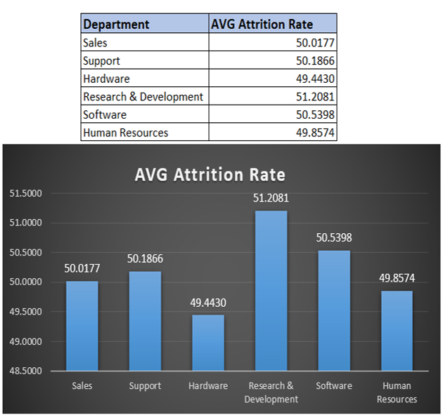
KPI-1: Average attrition rate for all departments
The insights driven using excel is shown here:
Data shows that Research & Development department has highest attrition rate while hardware has lowest.
We can see salary hike is not the reason of attrition cause R&D department getting good percentage salary hike.
In this department attrition of Females are more.
In HR, software department attrition of male is higher than female, while in other department female attrition rate is higher than male.
Work life balance is good for this department.
Attrition is more who has more working years in current role.
One reason can be the manager they are working under..

Slide 5
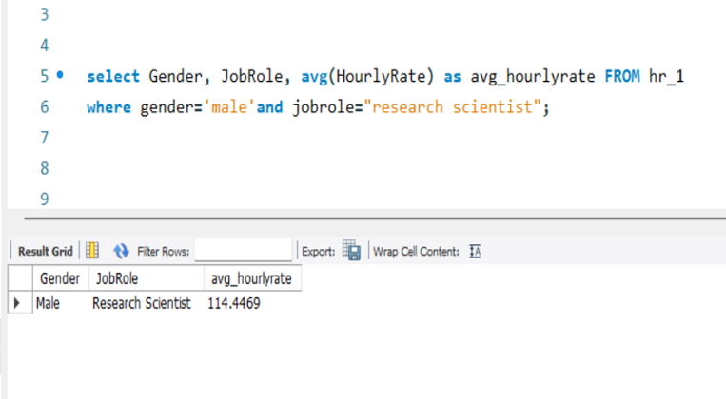
KPI-2: Average hourly rate of male research scientist
The insights driven using my SQL is shown here:
Min hourly rate = 30
Max hourly rate = 200
AVG hourly rate of male research scientist is as coming 114.45
While for female its 115.9
Work life balance for research scientist is average.

Slide 6
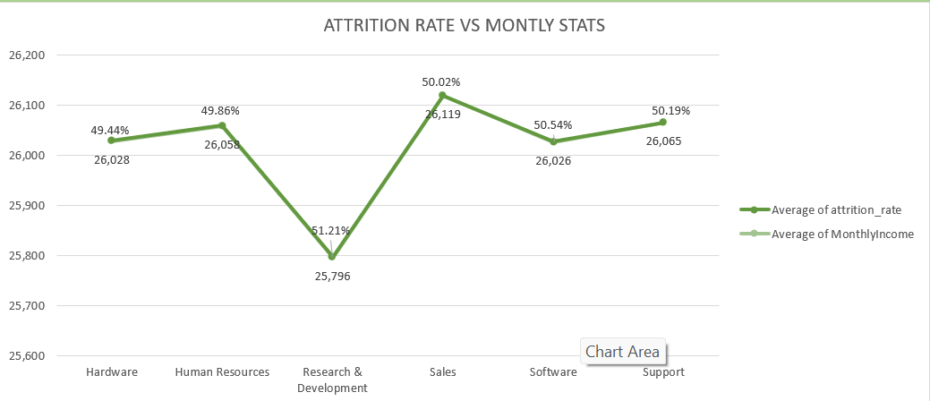
KPI-3: Attrition rate vs monthly income stats
The insights driven using power bi is shown here:
Min salary =1001
Max salary = 50999
Maximum salary hike is for 20-30k salary bin.
Max attrition is from 40-50k salary bin.
That may be because they are getting better salary
option in other company for the same work

Slide 7
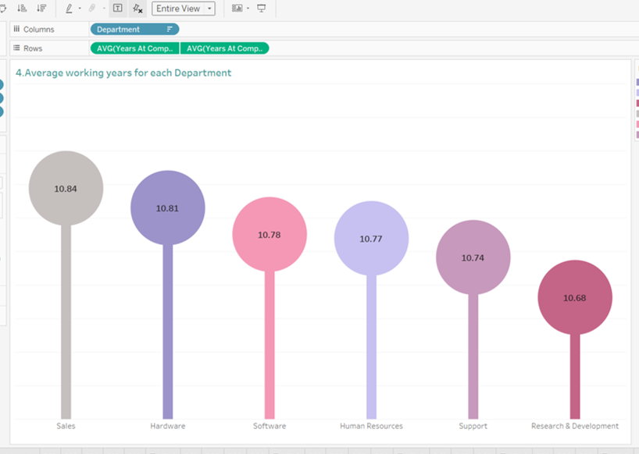
KPI-4: Average working years for each departments
The insights driven using Tableau is shown here:
Avg. working year for Sales department is highest and for R&D department its lowest.
But sales dept. has the lowest salary hike.
We have to work on R&D dept

Slide 8
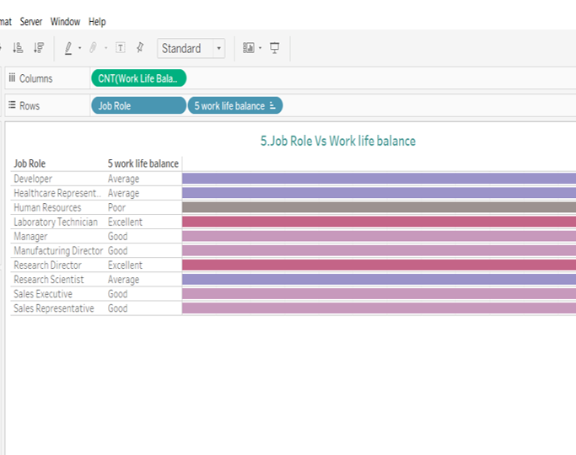
KPI-5: Job role vs work life balance
The insights driven using Tableau is shown here:
We can see that Laboratory technician and research director are having excellent work life balance.
While HR is having poor work life balance.
Employees from HR department are not getting promotion frequently and they are getting less monthly income.

Slide 9
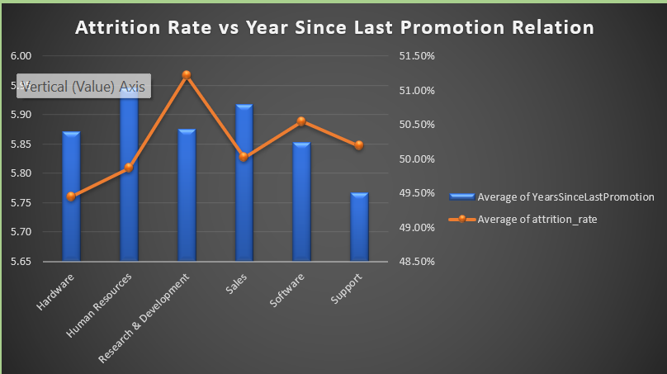
KPI-6: Attrition rate vs years since last promotion
The insights driven using Power bi is shown here:
The graph shows slight fluctuation for attrition of around 50% for the employee who have recently got promotion.
While the employees who have not got promoted for more than 20 years they shows more fluctuation in attrition graph.

Slide 10
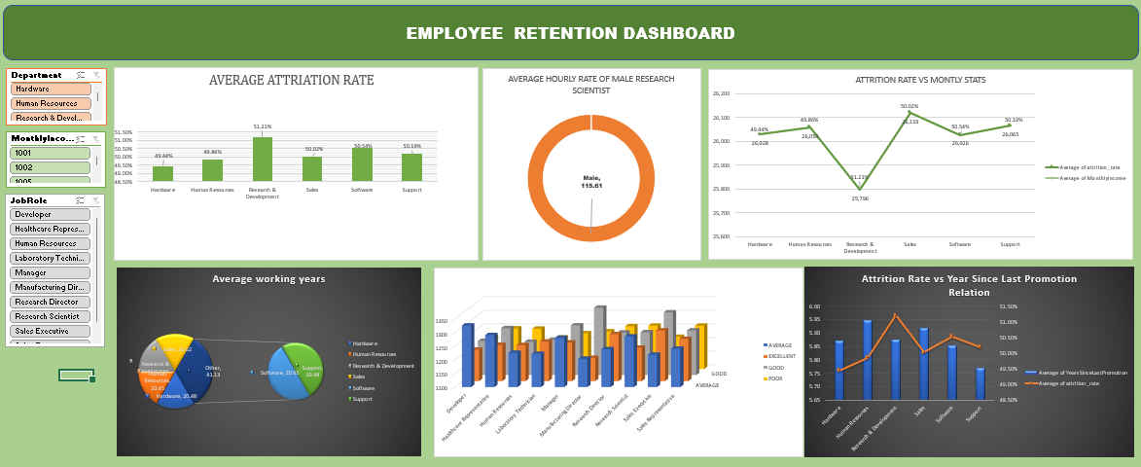
Excel Dashboard

Slide 11
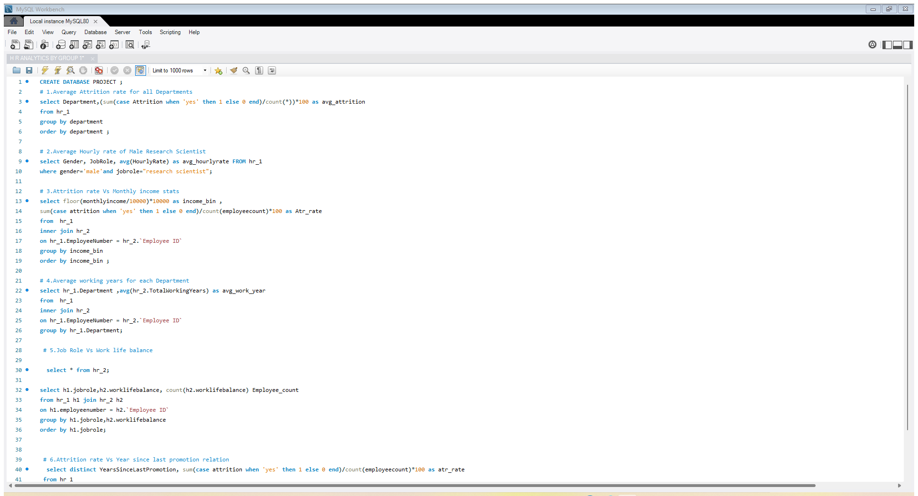
SQL DASHBORD AND QUERIES

Slide 12
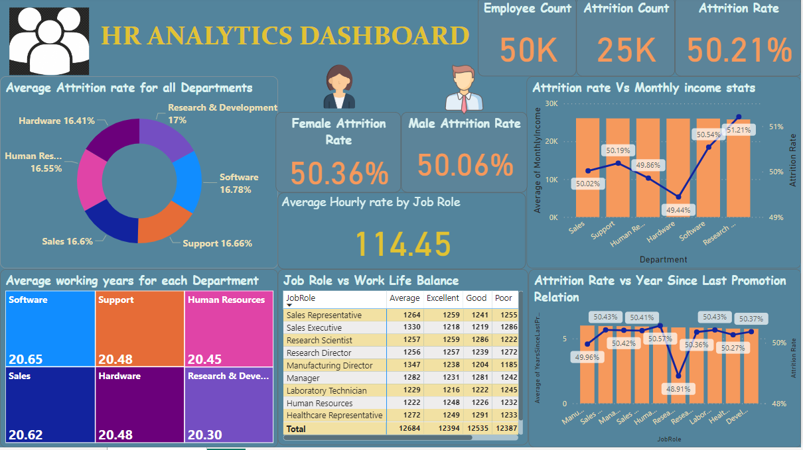
Power BI Dashboard

Slide 13
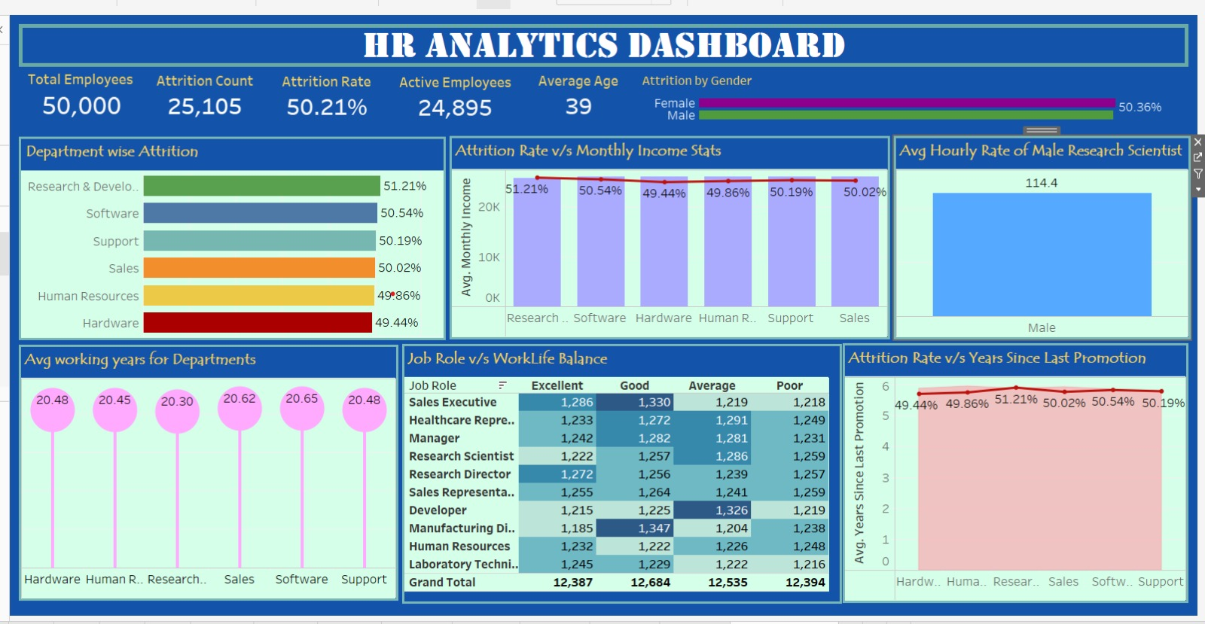
TABLEAU DASHBOARD

Slide 14
Recommendation:
Evaluate the distribution of monthly income across different employee groups to ensure fairness and equity in compensation practices.
Conduct a comprehensive review of salary structures and adjust them as needed to minimize income disparities and ensure competitive pay rates for all employees.
Encourage flexible work arrangements, such as remote work options or flexible hours, to empower employees to better balance their work and personal responsibilities. Provide managers with training and support to effectively manage remote teams and ensure productivity and collaboration.

Slide 15
Conclusion:
The insights derived from our HR data visualizations, it's evident that data-driven approaches play a crucial role in informing strategic HR decision-making and fostering a more engaged and productive workforce. By harnessing the power of data analytics, we've gained valuable insights into various aspects of our organization's human resources landscape, from attrition rates and compensation structures to work-life balance and career development opportunities. These insights have provided us with a deeper understanding of the challenges and opportunities facing our organization and have guided the development of targeted strategies and initiatives to address them.

Slide 16
THANK YOU

